Slide 1
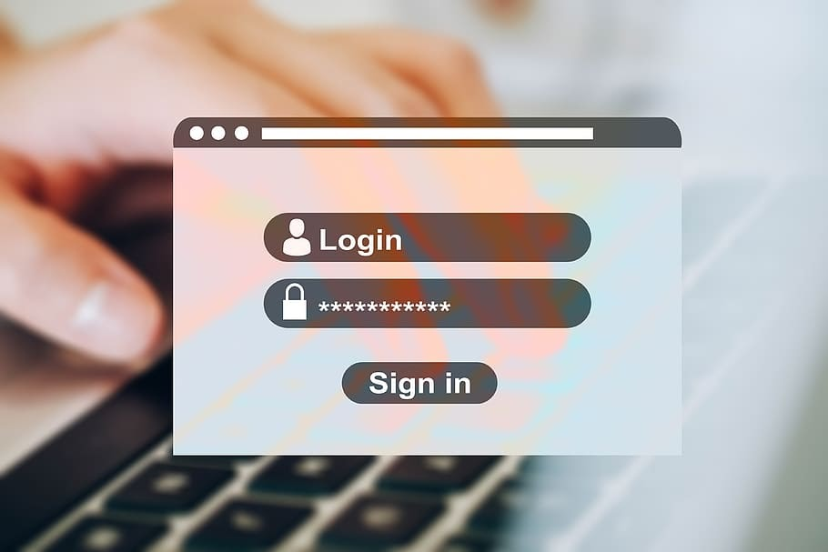
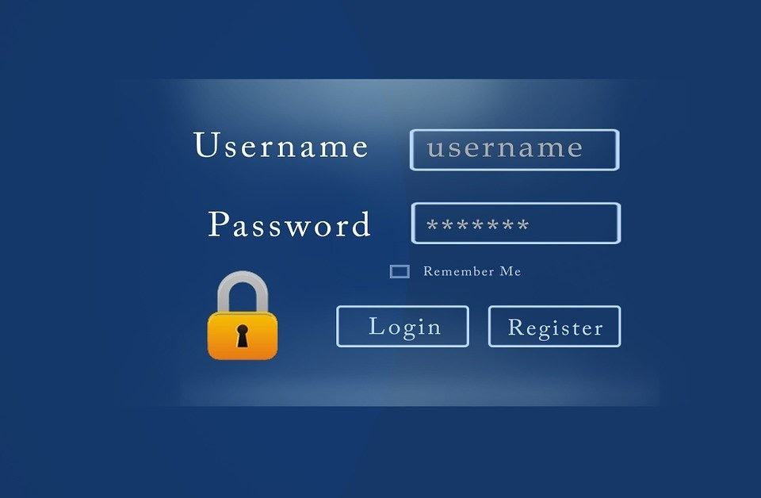


LOGIN AND
REGISTRATION SYSTEM

Slide 2
Presented by:
Lauren Alana Dsouza -4NM20CM016
Megha S -4NM20CM022
Sushmitha M -4NM20CM041
Submitted to:
MR.CHIDANAND T
DEPARTMENT OF COMPUTER
AND COMMUNICATION ENGINEERING

Slide 3

About the project:

Slide 4
The "Login and Registration System" has been developed to override the problems prevailing in the practicing manual system. This software is supported to eliminate and in some cases reduce the hardships faced by this existing system. The application is reduced as much as possible to avoid errors while entering the data. It also provides error message while entering invalid data. No formal knowledge is needed for the user to use this system. Thus by this all it proves it is user-friendly. Login System and Registration System , as described above, can lead to error free, secure, reliable and fast management system. It can assist the user to concentrate on their other activities rather to concentrate on the record keeping.

Slide 5
The language used is C++ and the editor/compiler used is Dev C++.
The aim is to automate its existing manual system by the help of computerized equipments and full-fledged computer software, fulfilling their requirements, so that their valuable data/information can be stored for a longer period with easy accessing and manipulation of the same. Basically the project describes how to manage for good performance and better services for the clients.

Slide 6

However you need to know c++

Slide 7
System Study:
The login page and register page should provide two text fields respectively - one for entering the user name and one for entering the password.
In the login page if either of the text fields has an error that must be reported to the user.
If both fields are filled in but there is no record of the user name or the password that must also be reported to the user
Users that have not yet registered cannot log in. They must first register by clicking on the register option.
Registration only happens the first time you access the system. It is a way to check your credentials.
Every time after your initial registration, you will log in to the system using the username and password you created.
In case the user has forgotten the user name or password, the user can search his Id by entering his username or password.

Slide 8
Objective:
The aim of the project is to automate the existing manual system by the help of computerized equipments and full-fledged computer software , fulfilling their requirements, so that their valuable data/information can be stored for a longer period with easy accessing and manipulation of the same. So basically the project provides better service and easily used by the users..
The main objective of this project is to manage the details of username ,password , login and registration. The purpose of the project is to build an application program to reduce the manual work for managing the username, password.
In this project we have to create three functions namely login, registration and other one called forget.(if the user forgets his username or password …this option will help him/her to login even if he/she forgets password!)
The fstream header file predefines a set or operations for handling files related to input and output. It defines certain classes that help to perform file input and output .C++ provides ifstream class to read from files and ofstream class to write on files and fstream is used to handle files.. this is because all the username and password input by the user will be stored in one file.. so inorder to access those files we need this headerfile! we can edit,add and update the records ,which results in proper resource management of username data..we may need to use simple switch case statement and while loop..
This project helps to maintain all the records input by the user such as username and password..

Slide 9

Umm Are you all interested to know how it works?

Slide 10
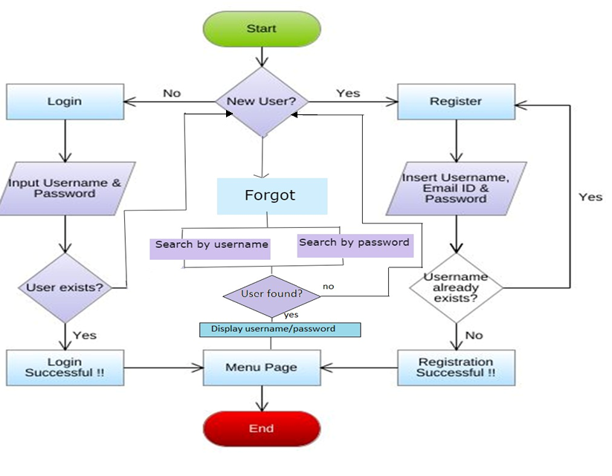
Flowchart:
No
No

Slide 11
Algorithm:
Ask the user to select a choice from the main menu displayed.
If the user enters 1 , get the username and password from the user.
If the user enters 2, get the username and password from the user and check both username and password in the file called “database”.
If username and password don’t match , then print login error and give the user a chance to find the correct username/password. If both match , ask the user to select a choice from the menu.
If the user enters 3, then give the user a chance to find the correct username/password either searching by username or password .
If the user chooses search by password then ask the user to enter the password he remembers and if the user chooses search by username then ask the user to enter the username he remembers.
Else if the user chooses 4, then exit from the program.

Slide 12
Implementation:
Platform used: C++
IDE tool: Dev-C++
Dev-C++ is a free full-featured integrated development environment (IDE) i.e it is a software application that provides comprehensive facilities to computer programmers for software development. An IDE normally consists of at least a source code editor, build automation tools and a debugger.
Compiler: MinGw compiler system . It can also be used with any other GCC-based compiler like Cygwin(a large collection of GNU and Open Source tools).

Slide 13

THANK YOU

